Slide 1

What is Dyslexia?
Pop Quiz
Quiz content comes from the Prezi and PowerPoint that you viewed in Lessons #1 and #2.

Slide 2
People with dyslexia have trouble matching the letters they see on the page with the sounds those letters and combinations of letters make.
Question #1

Slide 3
Dyslexia is not a neurobiological learning disorder.
Question #2

Slide 4
40% of people are dyslexic.
Question #3

Slide 5
The brain scans of dyslexic readers show increased activation in the of the brain that is known as “Broca’s Area.”
Question #4

Slide 6
After effective reading interventions, the brain scans of dyslexic students look much more like those of non-dyslexic readers.
Question #5

Slide 7
Dyslexic readers struggle with pseudowords (made-up words).
Question #6

Slide 8
Dyslexic see letters as reversed when they read.
Question #7

Slide 9
Dyslexics usually have intelligence levels that are below average.
Question #8

Slide 10
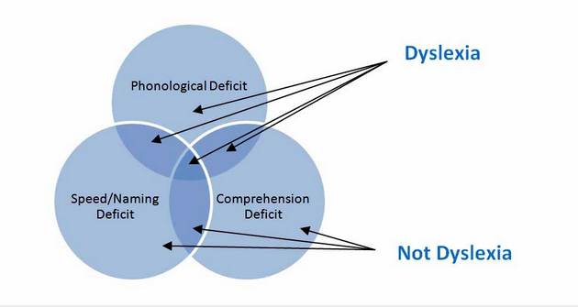
True
Question #1
People with dyslexia have trouble matching the letters they see on the page with the sounds those letters and combinations of letters make.
Sally Shaywitz says, “People with dyslexia have trouble matching the letters they see on the page with the sounds those letters and combinations of letters make.”

Slide 11
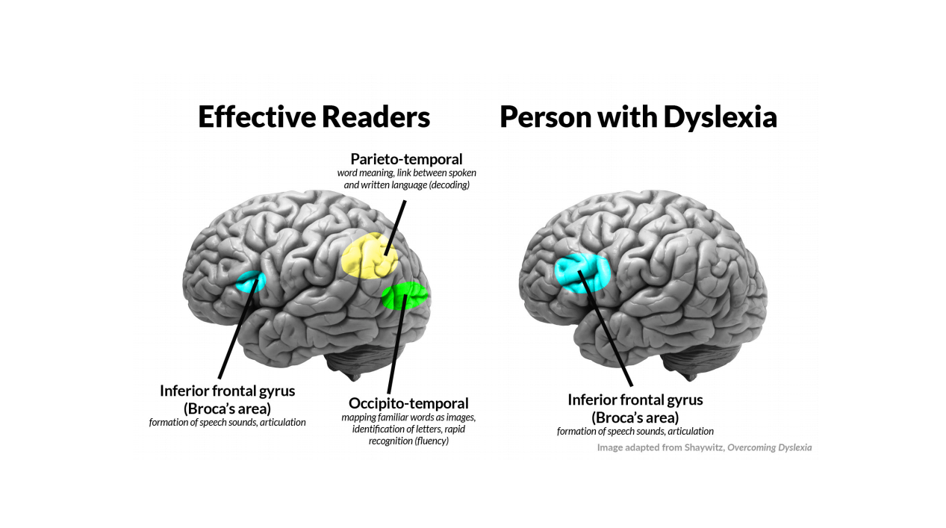
False
Question #2
Dyslexia is not a neurobiological learning disorder.
The International Dyslexia Association says, “Dyslexia is a specific learning disability that is neurobiological in origin.”

Slide 12
False
Question #3
40% of people are dyslexic.
It is estimated that 15-20% of people are dyslexic.

Slide 13
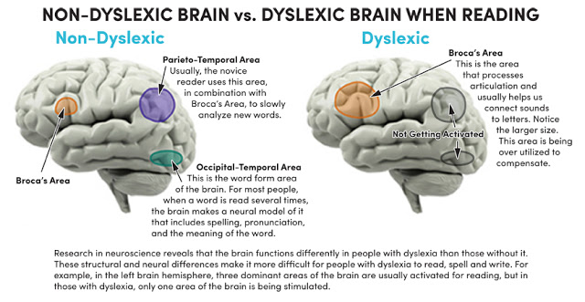
True
Question #4
The brain scans of dyslexic readers show increased activation in the of the brain that is known as “Broca’s Area.”

Slide 14
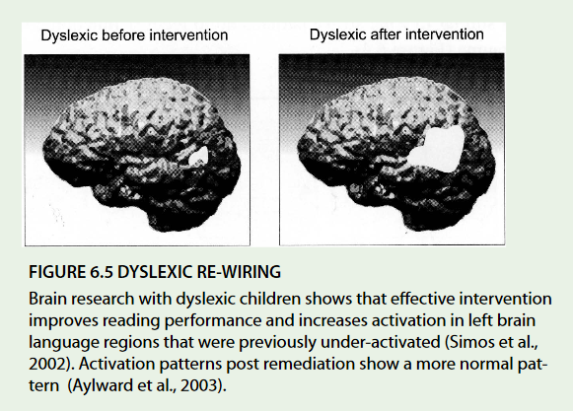
True
Question #5
After effective reading interventions, the brain scans of dyslexic students look much more like those of non-dyslexic readers.

Slide 15
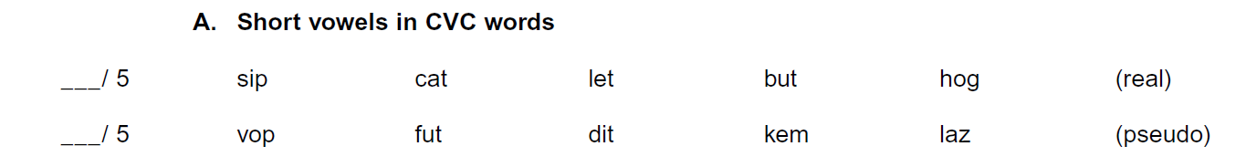
True
Question #6
Dyslexic readers struggle with pseudowords (made-up words).
Pseudowords are a great way to expose poor decoding skills. Since the student has not seen the word before, they will have to use their decoding skills to figure it out.

Slide 16
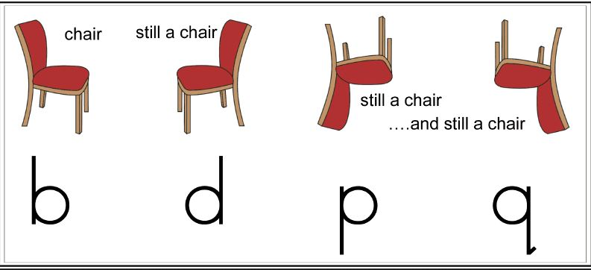
False
Question #7
Dyslexic see letters as reversed when they read.
“This was proven inaccurate by a study by Professor Frank Vellutino while at the University at Albany. He asked dyslexic and non-dyslexic American students to reproduce a series of Hebrew letters that none of them had ever seen before. The dyslexic students were able to perform the task just as accurately as the non-dyslexic students, showing that their dyslexia did not affect their eyesight.”
Excerpt from the University of Michigan’s Dyslexia Help website

Slide 17
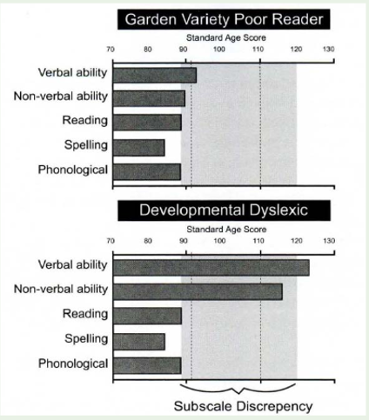
False
Question #8
Dyslexics usually have intelligence levels that are below average.
Sally Shaywitz says, “..dyslexia is an unexpected difficulty in reading in an individual who has the intelligence to be a much better reader. While people with dyslexia are slow readers, they often, paradoxically, are very fast and creative thinkers with strong reasoning abilities.”

